Slide 1
Reactive Android Intro: issues, examples and how to succeed with RxJava and Cascade
Lucia Payo and Paul Houghton
Futurice GmbH

Slide 2
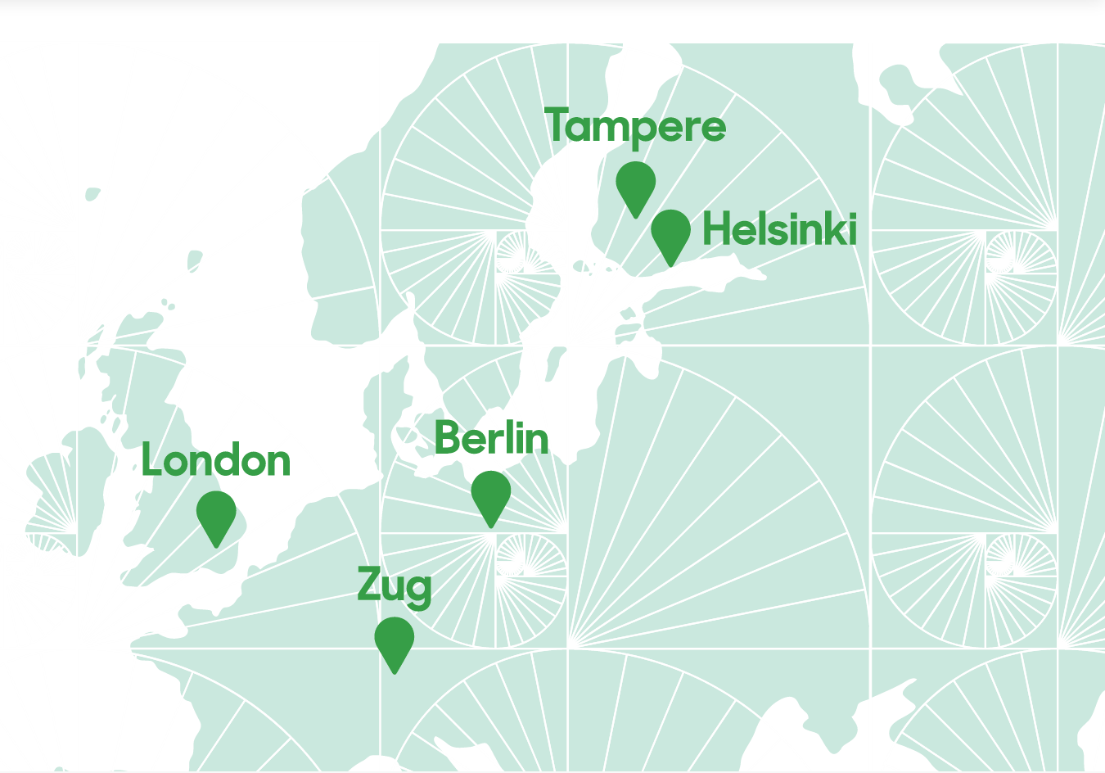


Slide 3
What is reactive programming?
Concepts
Let’s Code!

Slide 4
What is reactive programming?
Concepts
Let’s Code!

Slide 5
What is reactive?
Show a dialog after a double click

Slide 6
What is reactive?
Show a dialog after a double click
Multiple clicks == double clicks

Slide 7
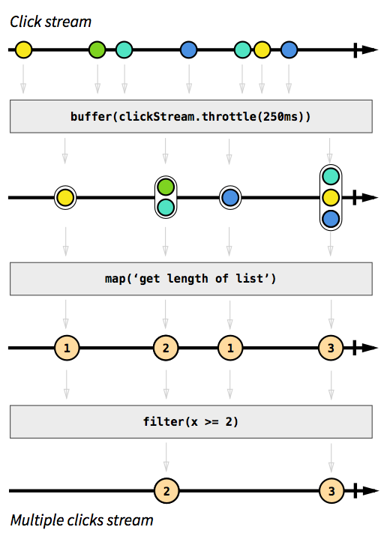
What is reactive?

Slide 8
What is reactive?

Slide 9
What is reactive?

Slide 10
What is reactive?

Slide 11
What is reactive?
Reactive programming is programming with asynchronous data streams

Slide 12
What is reactive programming?
Concepts
Let’s Code!

Slide 13
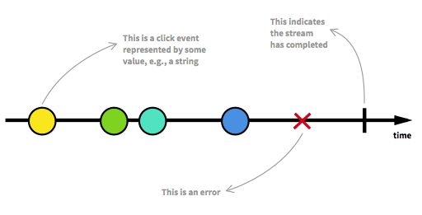
Concepts
The Observable

Slide 14
Concepts
Observable

Slide 15

Concepts
Observable
onComplete()
onError()
onNext()
Observer

Slide 16
Concepts
Observable
observable.subscribe(observer)
onComplete()
onError()
onNext()
Observer

Slide 17
Concepts
Observable
Subscription =
observable.subscribe(observer)
onComplete()
onError()
onNext()
Observer

Slide 18
Concepts
Observable
Subscription_1 =
observable.subscribe(observer_3)
Subscription_2 =
observable.subscribe(observer_2)
Subscription_3 =
observable.subscribe(observer_3)
onComplete()
onError()
onNext()
onComplete()
onError()
onNext()
onComplete()
onError()
onNext()
Observer_1
Observer_3
Observer_2

Slide 19
Concepts
Observable
Events
Events
Events
onComplete()
onError()
onNext()
onComplete()
onError()
onNext()
onComplete()
onError()
onNext()
Observer_1
Observer_3
Observer_2

Slide 20
Concepts
Observable = Stream, Producer
Observer = Consumer
Subscription = Contract

Slide 21
What is reactive programming?
Concepts
Let’s Code!

Slide 22
Let’s Code!
Search Widget Example
Implement dynamic “search”

Slide 23
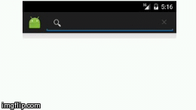
Let’s Code!
DON’T want to trigger a search for every letter

Slide 24
Let’s Code!
Trigger only after a small period of inactivity

Slide 25
Let’s Code!
Search Widget Example
Implement dynamic “search”
Encrypt the query

Slide 26
Let’s Code!
Search Widget Example
Implement dynamic “search”
Encrypt the query
Do something if the query matches the key word

Slide 27
RxJava by Square
Let’s Code!

Slide 28
Let’s Code!
Subject = Observable + Observer

Slide 29
Let’s Code!
Subject = Observable + Observer
Observer
subject.onNext(A);

Slide 30
Let’s Code!
Subject = Observable + Observer
Observer
subject.onNext(A);
Observable
A

Slide 31
Let’s Code!
Subject = Observable + Observer
Observer
Observer
subject.onNext(A);
subject.onNext(B);
Observable
A
B

Slide 32
Let’s Code!
Subject = Observable + Observer
Observer
Observer
Observer
subject.onNext(A);
subject.onNext(B);
subject.onNext(C);
Observable
A
B
C

Slide 33
Let’s Code!
Subject
Observer
Observer
Observer
subject.onNext(A);
subject.onNext(B);
subject.onNext(C);
Observable
A
B
C

Slide 34
Let’s Code!
Subject
Observer
Observer
Observer
subject.onNext(A);
subject.onNext(B);
subject.onNext(C);
Observable
A
B
C

Slide 35
Reactive programming changes the way you think

Slide 36

WELCOME
TO THE DARK SIDE

Slide 37

Reactive Cascade
Functional, Reactive, Different
“How do we develop easily
if everything was concurrent
by default?”

Slide 38
Psychology How to increase developer performance
Cascade
Increase Code Insight
Decrease Code Errors

Slide 39
Information Logistics How to increase runtime performance
Cascade
Increase
resource utilization rate
Decrease
Work In Progress
(WIP)

Slide 40
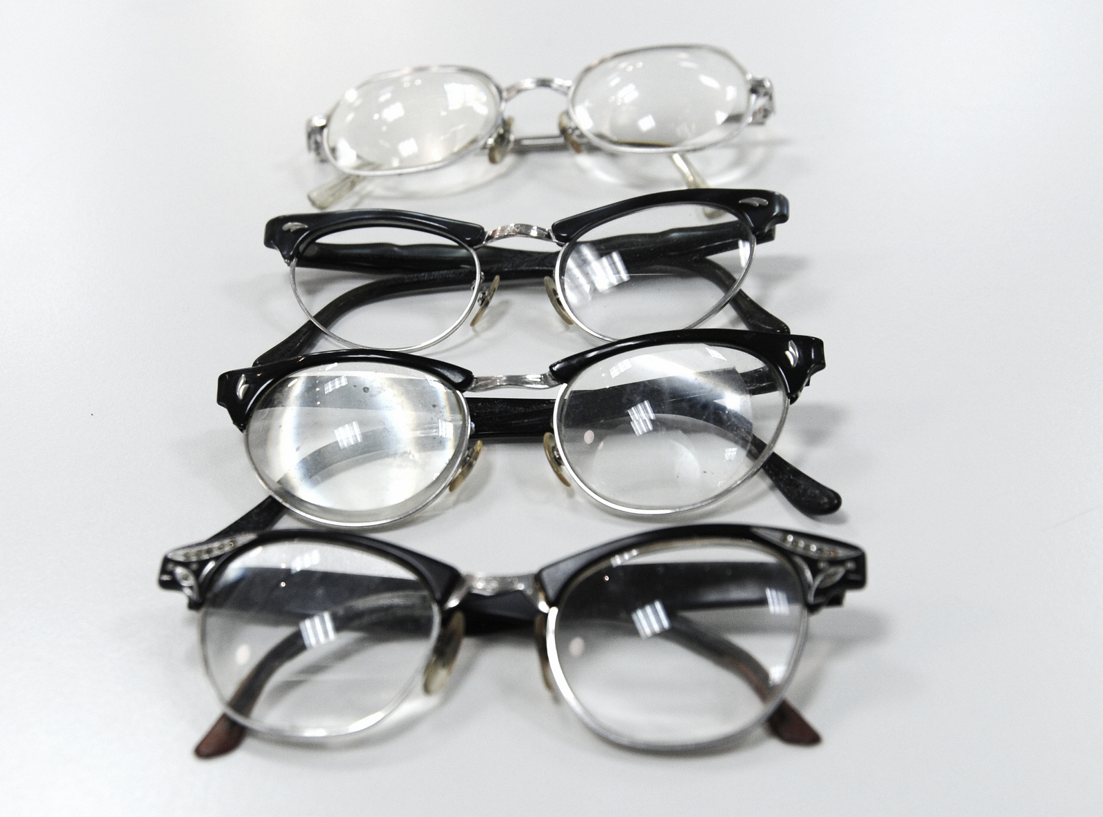
The Driver: Great UX
Cascade
(designer blah blah here)
Developer: architecture details
Task throughput
Speed over time
Task responsiveness
UX latency, first things first
Reliability
Trust contract with the user
https://www.flickr.com/photos/wonderlane/7167097899/in/photostream/lightbox/

Slide 41
Functional Example
Cascade
ImmutableValue<Integer> count = new ImmutableValue<>();
// I don’t yet know the value
// But I do know what I want to do when the value is determined
count.then(value -> println(“The count is “ + value));
..
count.set(34);
// Triggers one time logic run
// Count is now an immutable value object
// Clean for further functional use
The point: safely and easily throw logic around – it can happen concurrently on any thread

Slide 42
Functional Example
Cascade
SettableAltFuture<Integer> count = new SettableAltFuture<>(WORKER);
count.then(value -> recalculateSheetOne(value); // CORE 1
count.then(value -> recalculateSheetTwo(value); // CORE 2
count.then(UI, value -> println(“The count is “ + value)) // CORE 3
..
count.set(34); // ANY THREAD
Atomic operation from any thread triggers transform to immutable value object
Three down-chain actions run concurrently on the UI and two worker threads

Slide 43
Resource constraints determined execution thread groups: WORKER, UI, NET_READ, NET_WRITE, FLASH_READ, FLASH_WRITE
Cascade
WORKER Task Queue
UI Task Queue
2
2
1
recalculateSheetTwo(value)
1
0
recalculateSheetOne(value)
0
println(“The count is “ + value))
WORKER
Thread Group
1
2
3
4
5
6
7
8
UI
Thread Group
1
CPU Cores
1
2
3
4
5
6
7
8

Slide 44
Pre-made System Resource Constraint Thread Groups (or add your own)
Cascade
NET_WRITE
1
FLASH_WRITE
1
NET_READ
2 to 4
1
2
3
4
FLASH_READ
1
WORKER
1
2
3
4
5
6
7
8
UI
1
SERIAL_WORKER

Slide 45
Functional and Reactive: Use What Makes Sense To You
Cascade
Functional
Reactive
.then(action)
Fires once with .fork()
-> Great for adapting existing libraries
.subscribe(action)
Fires each time the source changes
Automatic cleanup
-> Great for MVVM
-> Great for fast business logic

Slide 46
Reactive Concurrent Example
Cascade
AtomicValue<Integer> angle = new AtomicValue<>(WORKER, “Angle”);
angle.subscribe(degrees -> viewModel.updateAngle(degrees))
.subscribe(degrees -> mapToRadians(degrees))
.subscribe(UI, radians -> updateDialOnScreen(radians));
..
angle.set(90); // From any thread
// -> Cascade of concurrent downchain actions on each set

Slide 47
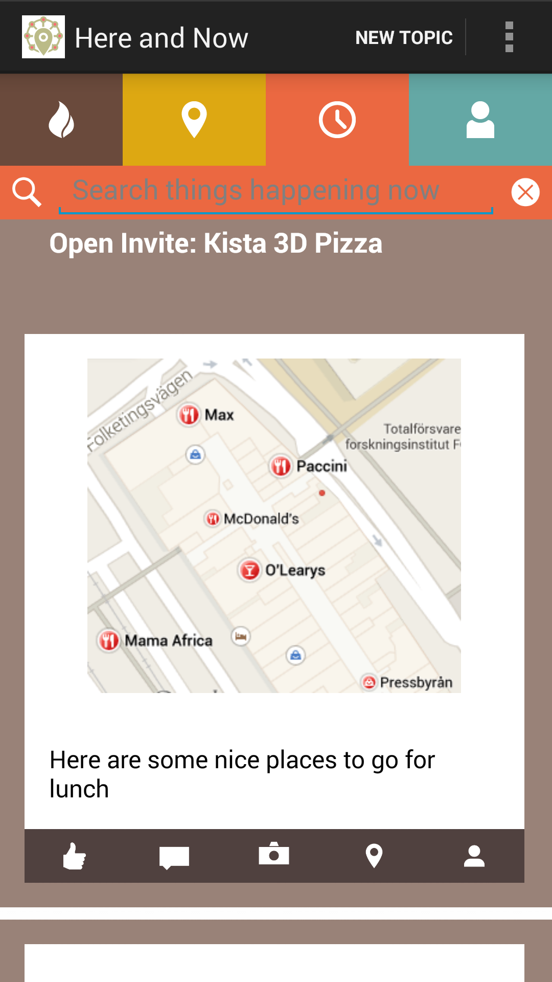

Cascade

Slide 48
The issues
Activity/Fragment life-cycle
Error handling
Logs
Back Pressure
Hot & Cold Observables

Slide 49
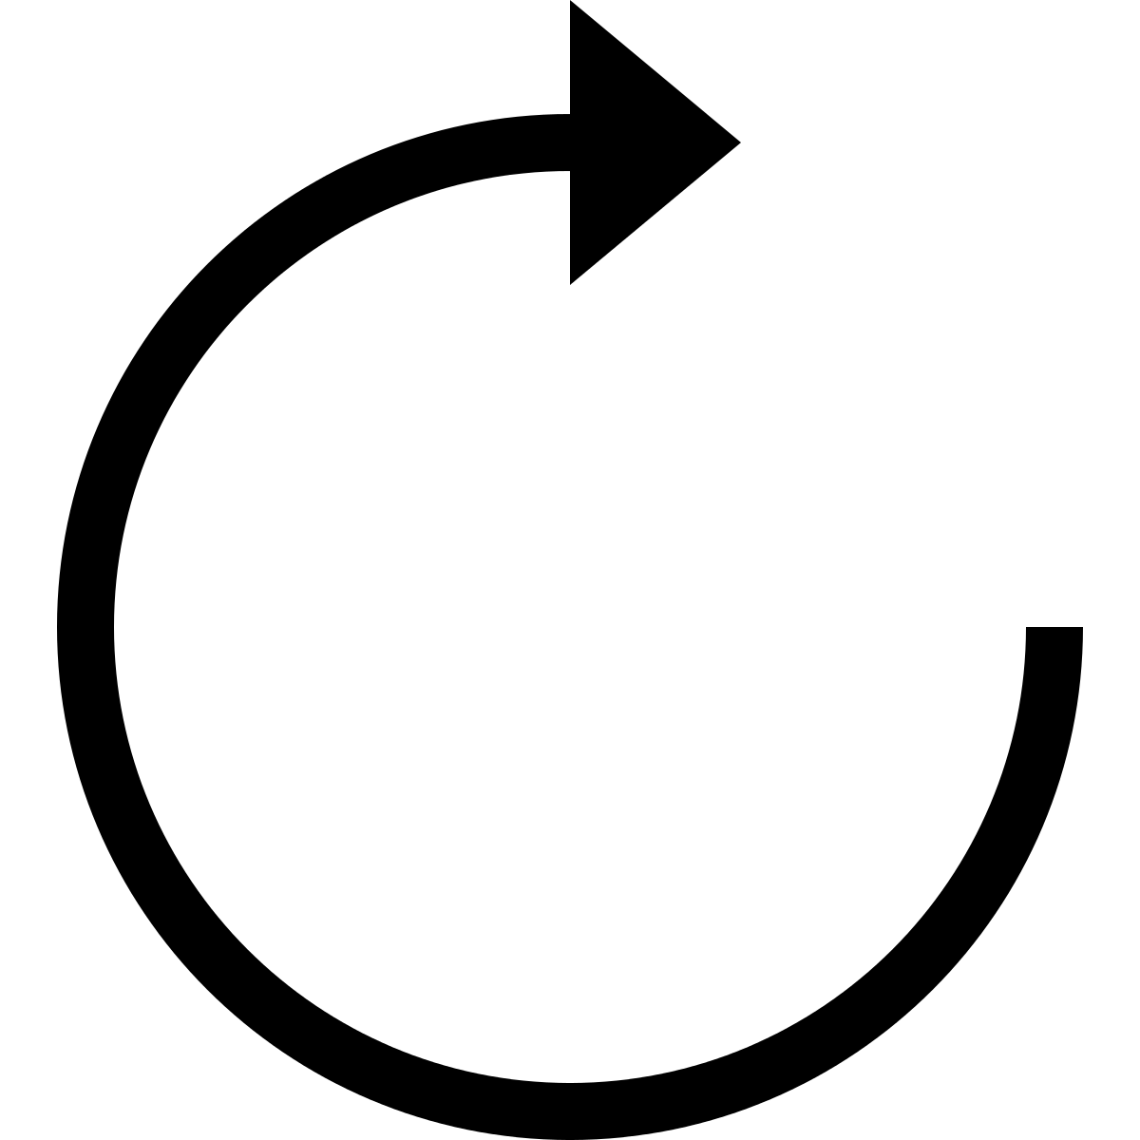
Life-cycle
RxJava
Event
Activity / Fragment
Transformations in background thread
Observer

Slide 50
Life-cycle
RxJava
Event
Activity / Fragment
Transformations in background thread
???
Observer
DESTROYED

Slide 51
Life-cycle
RxJava
Event
Activity / Fragment
Transformations in background thread
???
Observer
DESTROYED
EXCEPTION + MEMORY LEAK

Slide 52

Life-cycle
RxJava
Bind the observable to the Activity/Fragment life-cycle
Activity/Fragment
Observable
AppObservable.bindActivity(activity, observable);
AppObservable.bindFragment(fragment, observable);

Slide 53
Life-cycle
RxJava
Handle the subscriptions
&
unsubscribe!

Slide 54
Life-cycle
RxJava
Enable Strict Mode

Slide 55
Life-cycle
Cascade
Cleanup, unsubscribe, boring plumbing work prone to errors..
// This space intentionally left blank

Slide 56
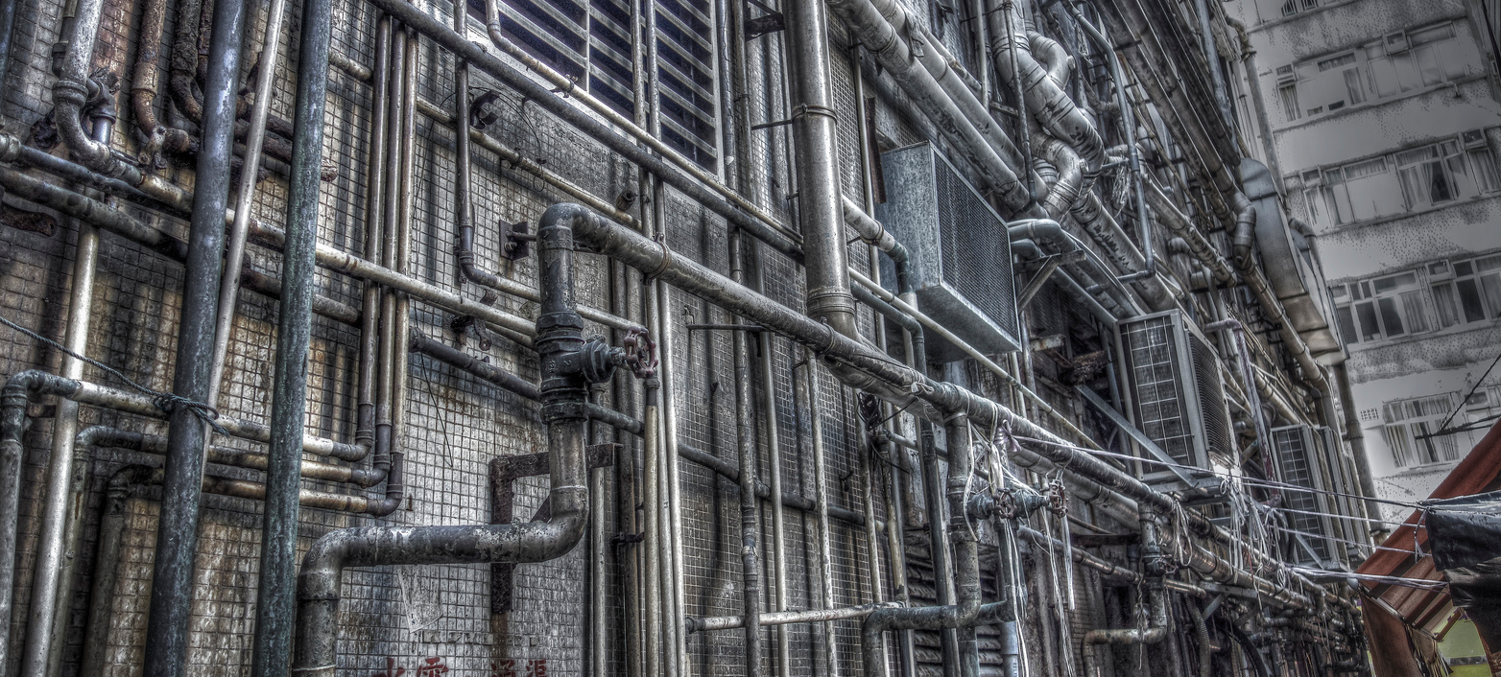
Plumbing, Fred Minh

Slide 57
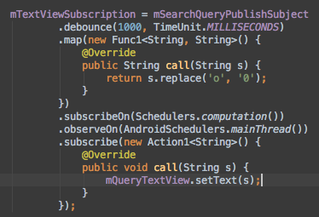
Error Handling
RxJava
Actions
Notes:
RxJava does not swallow exceptions (as it should be). It is possible to subscribe an Action instead of an Observer. In the piece of code above if there is a null pointer exception inside the map operator the app will crash because the error is not handled.

Slide 58
Error Handling
RxJava
Error event ends the subscription
Notes:
Another characteristic of RxJava is that the error event terminates the subscription. What if this is not the desired behavior? What if we want to maintain the subscription? There are some operators to workaround.

Slide 59
Error Handling
RxJava
Error event ends the subscription
There are some workarounds
Operators
Notes:
Another characteristic of RxJava is that the error event terminates the subscription. What if this is not the desired behavior? What if we want to maintain the subscription? There are some operators to workaround.

Slide 60
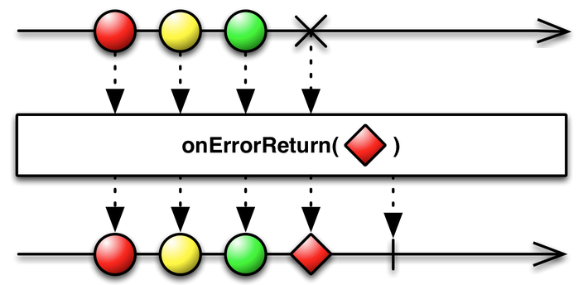
Error Handling
RxJava
Operators for Error Handling
Notes:
onErrorReturn mirrors the behavior of the observable but when there is an error it emits the passed element and completes. The resulting observable never errors.

Slide 61
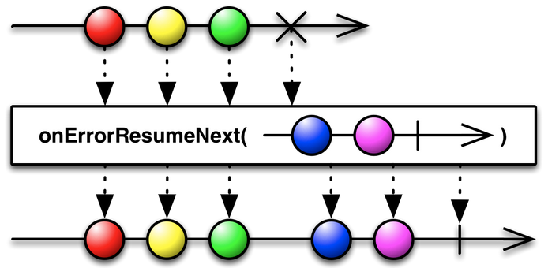
Error Handling
RxJava
Operators for Error Handling
Notes:
onErrorResumeNext switches to a different observable (passed to the method) when there is an error. The resulting Observable never errors.

Slide 62
Error Handling
Error Handling
Cascade
NET_READ.then(() ->
return getMessagesServer())
.then(WORKER, (raw) -> {
return parseMessages(raw))
}
.then(NET_WRITE, (MyDataType parsedList) -> {
storeToFlash(parsedList);
}
.then(UI, (MyDataType parsedList) -> {
display(result))
}
.onError(() ->
popupError(“Stopped at count “ + count.get());
Error handling is automatic and fail-fast in debug builds
You can add your own in-chain actions

Slide 63
Logs
RxJava
Using RxJava everywhere
Observes
VIEW
MODEL
Observes

Slide 64
Logs
RxJava
Where is the trigger?
Events that trigger other events
Longer chains
Logs with RxJava internals
Higher complexity
DIFFICULT TO TRACK DOWN!

Slide 65
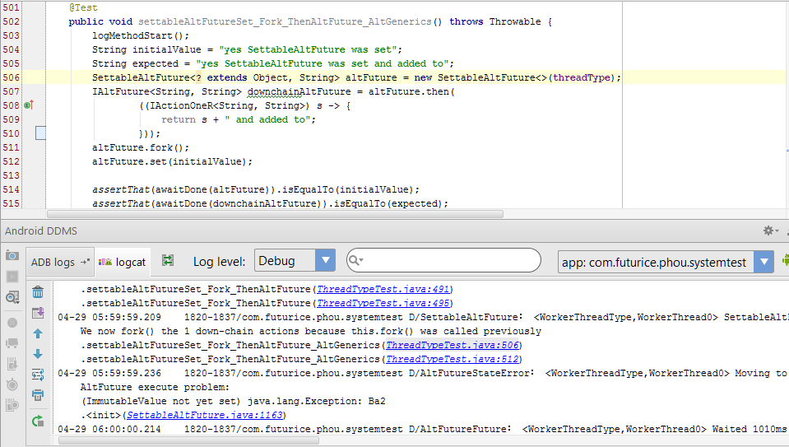
Logs
Cascade

Slide 66
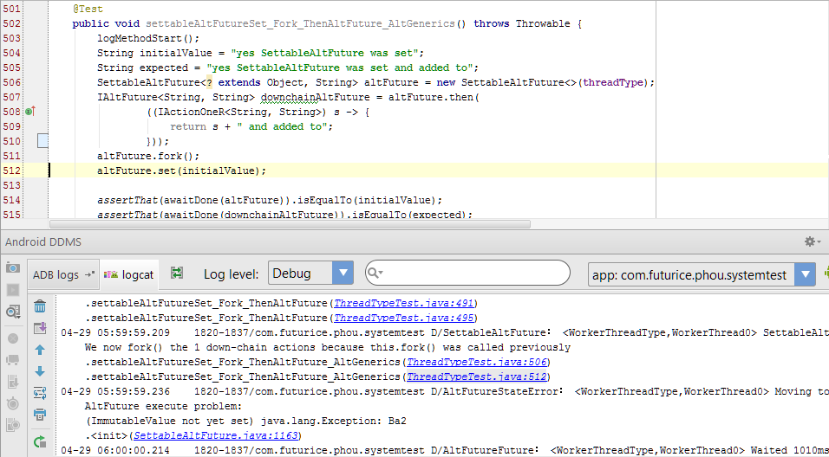
Logs
Cascade

Slide 67
Back Pressure
RxJava
What if the observable produces faster than the observer can consume?

Slide 68
Back Pressure
RxJava
What if the observable produces faster than the observer can consume?
It has to go through all the transformations
Takes time

Slide 69
Back Pressure
RxJava
What if the observable produces faster than the observer can consume?
It has to go through all the transformations
Takes time
How to handle backpressure:
https://github.com/ReactiveX/RxJava/wiki/Backpressure

Slide 70
Back Pressure
Cascade
The Good
We use queues instead
Concurrent, 4x or 8x faster
Generally no bogging
Depth-first task tree execution
Low task latency once the chain starts
Low Work In Process (WIP)
Reactive chains pull inputs
They “skip intermediate steps”
The Ugly
Shared queue, shared problem
The queue _can_ grow
Very slow tasks
Bad design
Bypass a bogged executor
Create a dedicated executor
Trigger source quench when the problem queue exceed a set length

Slide 71
Hot & Cold Observables
RxJava
When does an Observable start emitting items?

Slide 72
Hot & Cold Observables
RxJava
Hot Observable
subscribe
Observer

Slide 73
Hot & Cold Observables
RxJava
Cold Observable
subscribe
Observer

Slide 74
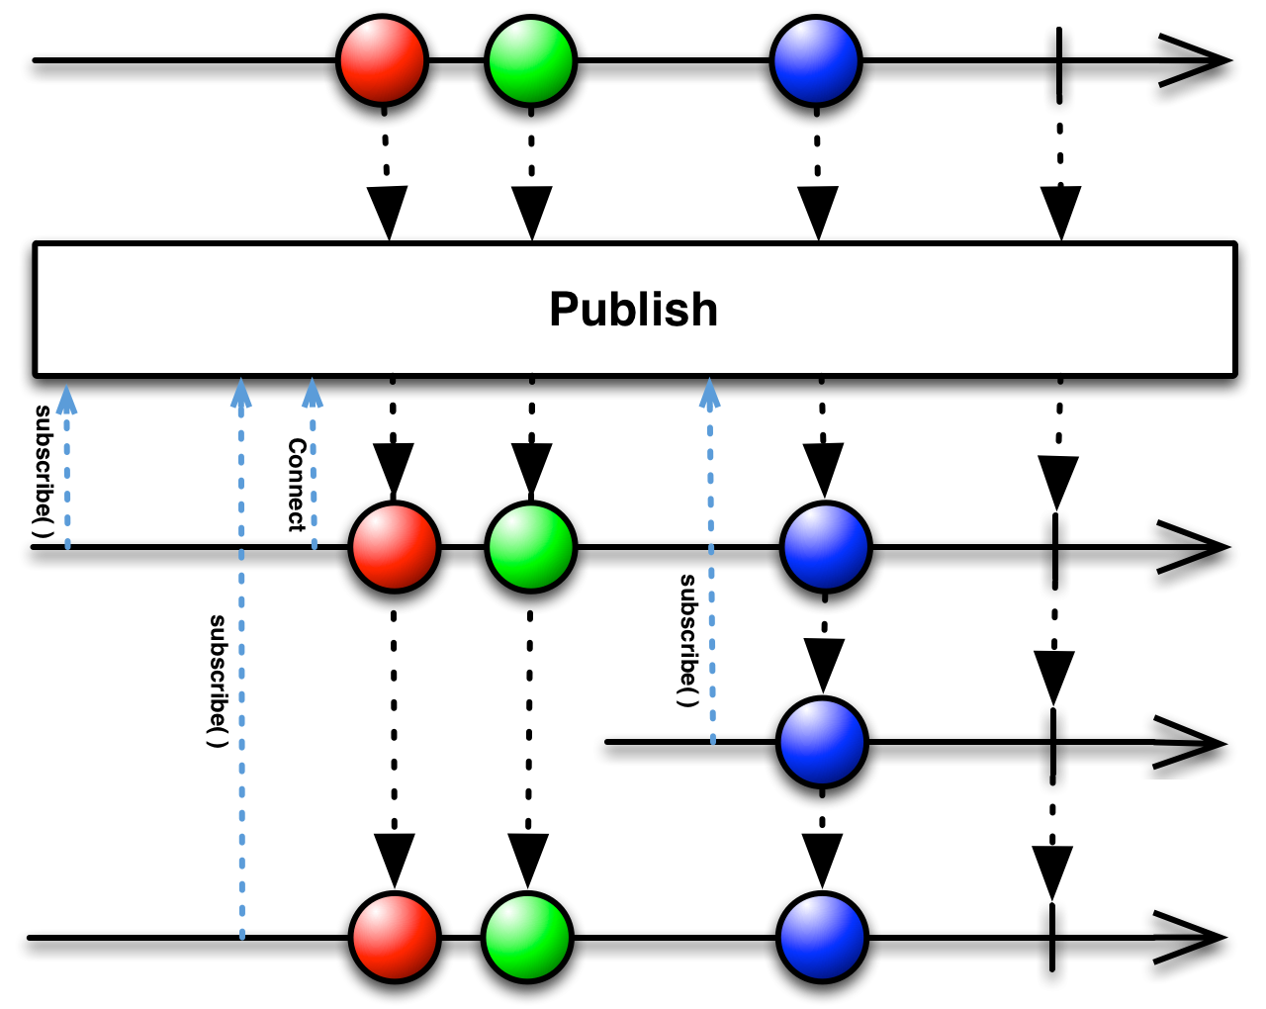
Hot & Cold Observables
RxJava
Connectable Observable

Slide 75
Hot & Cold Observables
Cascade
Simple: Everything is cold
Functional
.fork() the chain to queue for execution
Reactive
.fire() to force current value to (re)evaluate the chain
Or wait for the next .set(value) change

Slide 76
WELCOME
TO THE DARK SIDE

Slide 77
The introduction to RxJava you’ve been missing:
https://gist.github.com/staltz/868e7e9bc2a7b8c1f754
Reference architecture for Android using RxJava:
https://github.com/tehmou/rx-android-architecture
Don’t break the chain:
http://blog.danlew.net/2015/03/02/dont-break-the-chain/
Reactive wiki:
http://reactivex.io/
Top 7 tips for RxJava on Android:
http://futurice.com/blog/top-7-tips-for-rxjava-on-android

Slide 78
Interactive diagrams of Rx Observables: http://rxmarbles.com/
Reactive Cascade https://github.com/paulirotta/cascade
LINK TO THIS PRESENTATION:

Slide 79


Thanks!
lucia.payo@futurice.com
paul.houghton@futurice.com
@mobile_rat

